Slide 1
UML Class Diagram
Models one class
Documents the things which are defined/declared within the class
Rectangle with 3 sections
First section: class name
Second section: class variables / attributes
Third section: methods defined/declared within the class (behaviours)
Notes:
OOP2 Slides set 1. A nic Gearailt
1

Slide 2
Classes and Objects
Classes define what a class of things can do, and what attributes define them
Objects are the actual things: they can do the same things, but have different identities and different values for the attributes
An object is an “instance of a class”
Notes:
OOP2 Slides set 1. A nic Gearailt
2

Slide 3
Why use UML for design?
Most real OO systems are made up of many inter-related small classes.
If UML is used to design a system, a code generator can supply a lot of the routine code for the classes – things like the class header and braces, the headers for all the methods, the declarations for all the attributes.
Notes:
OOP2 Slides set 1. A nic Gearailt
3

Slide 4
How big is the UML?
There are about 30 different types of diagrams
And about 20 types of connector
You only need for this module:
class diagram
VOPC diagram
some simple connectors (needs, is-a, has-a, implements)
Notes:
OOP2 Slides set 1. A nic Gearailt
4

Slide 5
UML Class diagram, Welcome1.java
Welcome1
‘+’ denotes public
static methods are underlined
return type comes last
name comes before type, separated by ‘:’
+ main (args[ ] : String) : void
Notes:
OOP2 Slides set 1. A nic Gearailt
5

Slide 6
Things not included in class diagram
Methods from other classes which are used by main() do not appear in the methods section.
Local variables declared within main() do not appear in the ‘attributes/variables’ section.
Notes:
OOP2 Slides set 1. A nic Gearailt
6

Slide 7
Partial Class Diagram for JOptionPane
JOptionPane
There are other methods in this class
Exercise: Search the ‘doc’ files to see how to put a title on the input dialog, and how to include an icon
+ showMessageDialog (parent:Component, str: String)
+ showInputDialog (prompt : String) : String
Notes:
OOP2 Slides set 1. A nic Gearailt
7

Slide 8
UML VOPC diagram
View Of Participating Classes
A VOPC diagram is a set of interconnected class diagrams, and shows all the classes needed for a particular application to run
Rectangle (class diagram) for each class.
Level of detail varies.
Dependencies indicated by lines or arrows.
Notes:
OOP2 Slides set 1. A nic Gearailt
8

Slide 9
UML connectors
A line between two classes in a VOPC diagram indicates a dependency or relationship.
This can be something like ‘needs’, ‘has a’ or ‘is a’: and can involve ‘one to one’, ‘one to many’ or ‘many to one’ relationships
The symbol at the end of the connector tells you something about the nature of the relationship
Notes:
OOP2 Slides set 1. A nic Gearailt
9

Slide 10
Packages
A package is a set of related classes stored in the same folder
The Java API classes are divided into packages
Packages always have lower-case names
java.lang contains classes like String, Math and System and is always available
if a program needs a class from another package, it must either import the class, import the whole package, or refer to the class by its fully-qualified name, eg javax.swing.JOptionPane
Notes:
OOP2 Slides set 1. A nic Gearailt
10

Slide 11
VOPC diagram for WelcomeDialog1
java . lang
javax.swing
String
JOptionPane
WelcomeDialog1
+main()
Notes:
OOP2 Slides set 1. A nic Gearailt
11

Slide 12
In a VOPC diagram
Sometimes all the methods being used from a class are shown (in the case of user-written classes), sometimes just the class
The package of each class is usually shown The classes in java.lang are not usually shown, as they are always available
Notes:
OOP2 Slides set 1. A nic Gearailt
12

Slide 13
VOPC diagram for NameAgeDialog3
java . lang
javax.swing
String
JOptionPane
Integer
Double
NameAgeDialog3
+main()
Notes:
OOP2 Slides set 1. A nic Gearailt
13

Slide 14
Types of classes
Application class: has a main method. Does something. Welcome1
Utility class: contains useful static methods and constants accessed by prefixing the class name eg Math.PI, JOptionPane.sID
Instantiable class: a template for a class of objects eg String, JButton, Student
Applet: like an application, but designed to run from a web browser (no main method)
Notes:
OOP2 Slides set 1. A nic Gearailt
14

Slide 15
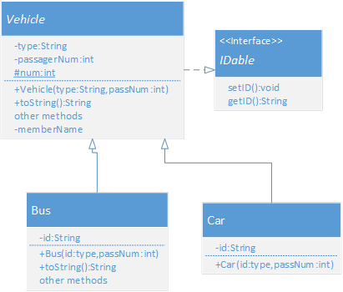
Implements
extends

Slide 16
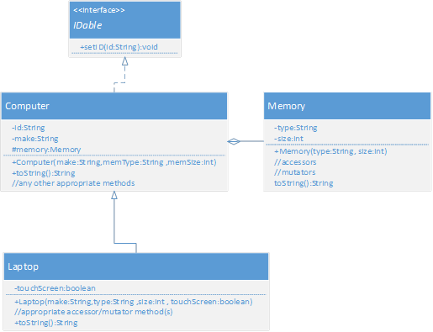
Is composed of
Implements
extends

Slide 17
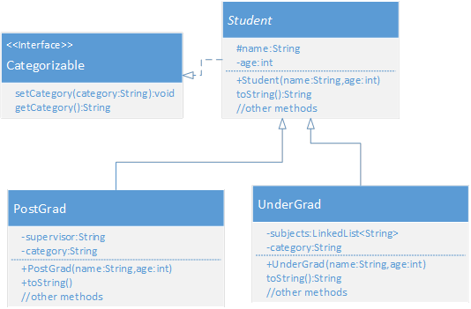

Slide 18
